Slide 1
Decision Making Fundamentals
There is a Clever Description of this Somewhere in My Brain

Slide 2

Decision Trees
Decision trees help agents make decisions (actions) by branching based on aspects of the world (aka knowledge) at a particular time.
Decision Trees…
Ask some question about world / agent
Branch according to possible answers
Terminate in decisions (leaf nodes)
Decision trees can use machine learning
Decision tree models have largely given way to
the more recent Behavior Tree model in games.
Zombie?
Yes
No
Hungry?
Yes
No
Hide
Eat Brains
Moan

Slide 3
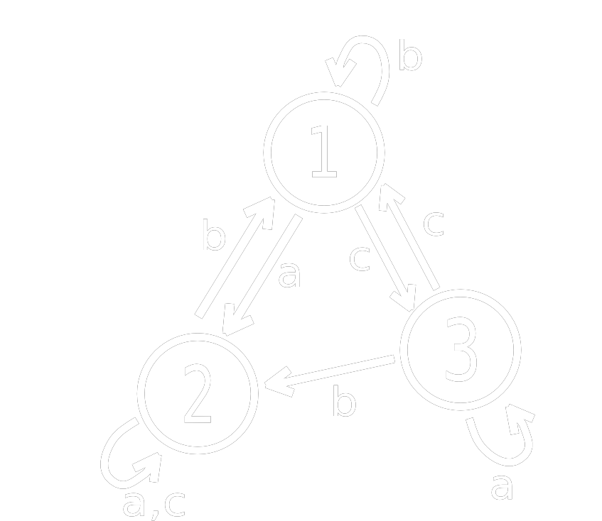
Finite State Machines
Finite State Machines
Memory is only the current state
Changes triggered by input
Begins in the start state

Slide 4
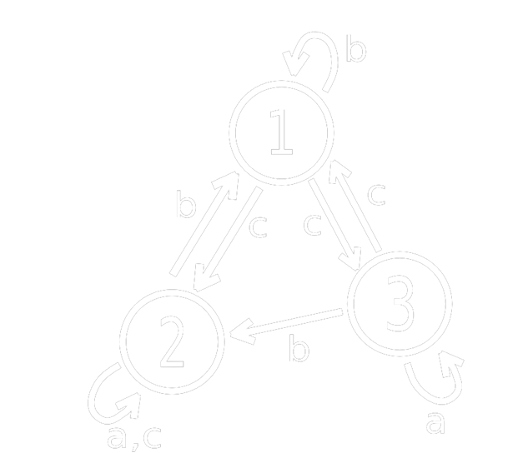
Determinism vs. Non-Determinism
Deterministic FSMs:
Are completely predictable
Have exactly one action for each input
Non-deterministic FSMs:
Are unpredictable
Can have any number actions for an input

Slide 5
FSMs in Games
Structure
Every frame, current state runs code
In its first update, a state should initialize
In its last update, a state should have exit code
Transitions
Transitions will be stored in a transition table
Machines will accept engine events as input
We will attempt to make a state machine that is as generic as possible so the code can be reused.

Slide 6

Coding an FSM
class StateMachine
{
list<State*> states;
State *current, *start;
int transition[#s][#i];
queue<Event*> events;
void Init();
void Update();
void Shutdown();
void EnqueueEvent(Event*);
void Transition();
}
class State
{
void enter();
void update();
void exit();
}

Slide 7
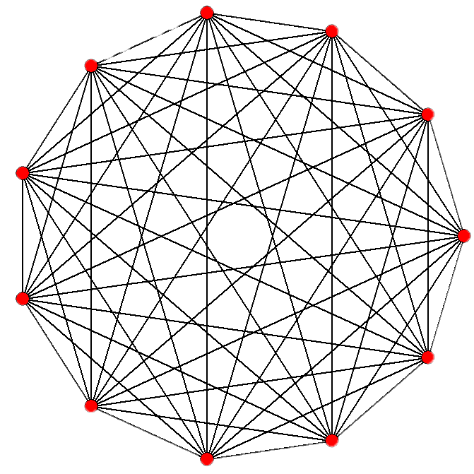
FSM Problems
Finite State Machines are easy to code and have been very successful in games, but have some problems:
Don’t scale well (spaghetti)
No memory of past events
Purely reactive – no plans/goals
Can be too predictable
Scaling can be handled to some degree with Hierarchical FSMs (HFSMs). And predictability can be addressed with probabilities, as discussed earlier – but as always, at a cost!

Slide 8
Agent Behaviors
A behavior is a way an agent thinks & acts.
Behaviors can be…
Simple (e.g. scripted)
A composition of behaviors
After running a behavior, it will return a status:
Success (completed)
Failure (did not complete)
Running (suspends tree processing to return later)
We should try to give players as much information as possible about the AI’s mind: animation, audio cues, personality, etc.

Slide 9

Behavior Trees
We can use Behavior Trees to model agent behaviors.
Behavior Types and Examples:
Primitives
Conditions
Actions
Decorators
Loop
Wait
Invert
Composites
Sequences
Selectors
Parallels

Slide 10
Conditions & Actions
Conditions and actions are the most basic behaviors.
Conditions check the status of something in the world.
Are enemies nearby?
Is the character attacking?
Do I have a key?
Actions do something that alters the world in some way.
Grab pick-axe
Push block to the left
Eat a sandwich
Is Door Open?
Open Door

Slide 11
Decorators
A decorator adds flexibility or control to an action without modifying that action’s code.
Some decorator types:
Loop
Retry
Inverter
Counter
Timer
Debug Node
Guard (semaphore)
Do 2 Times
Find Door Key

Slide 12
Sequences
A sequence is a set of behaviors all of which must complete for the sequence to succeed.
If any child fails, the sequence immediately fails.
Approach Enemy
F
S
Locate Enemy
S
Plan Path to Enemy
S
Follow Path to Enemy
S
F
F
F

Slide 13
Selectors
A selector is a set of behaviors any one of which must complete for the selector to succeed. They are normally picked from left to right but can also use priorities or randomness.
If any child succeeds, the selector immediately succeeds.
Attack Enemy
S
F
Gun Attack
F
Knife Attack
F
Magic Attack
F
S
S
S

Slide 14
Behavior Tree Example
Attack Sequence
Root Selector
Starting with the root behavior, behaviors are chosen until one returns a running status, or the entire tree succeeds/fails. Yellow arrows indicate order of evaluation.
Player Seen?
Gun Sequence
Patrol Hourly
Sequence Parallel
Find Ammo
Shoot Player
Patrol Parallel
= compound task
= decorator
= action
= condition
Whistle
Walk Around

Slide 15
Behavior Tree Example – Run 1
In the first traversal, the player is seen, but finding ammo will take more than one tick.
Attack Sequence
Root Selector
= visiting
= succeeded
= failed/aborted
= running
Player Seen?
Gun Sequence
Patrol Hourly
Find Ammo
Shoot Player
Patrol Parallel
= compound task
= decorator
= action
= condition
Whistle
Walk Around

Slide 16
Behavior Tree Example – Run 2
Attack Sequence
Root Selector
In the second traversal, we resume at the running node and later succeed in shooting the player.
= visiting
= succeeded
= failed/aborted
= running
Player Seen?
Gun Sequence
Patrol Hourly
Find Ammo
Shoot Player
Patrol Parallel
= compound task
= decorator
= action
= condition
Whistle
Walk Around

Slide 17
Behavior Tree Example – Run 3
Attack Sequence
Root Selector
In the third traversal, the player is not seen. We try to patrol but fail at walking, so the patrol fails.
Player Seen?
Gun Sequence
Patrol Hourly
= visiting
= succeeded
= failed/aborted
= running
Find Ammo
Shoot Player
Patrol Parallel
= compound task
= decorator
= action
= condition
Whistle
Walk Around

Slide 18
Behavior Trees Benefits & Drawbacks
Benefits
Easy to understand and control
Fast run-time execution
Flexible / scalable in complexity
Can be built and tweaked rapidly (graphical tools)
Drawbacks
Reactive in nature
Planning behaviors require development
Slow to respond to urgent events

Slide 19

Fin

